Slide 1

Hosted by: JCI XXXXX Date: November 22, 2014 Speaker: XXXXXX Position: 2015 XXXXXX
PHILIPPINES
Journey from Efficiency to Performance
to Impact and Positive Change
(Area / Region / LO)
Notes:
NOTES:
Please have the following prepared before the Cascade
Requirements:
Printed JCIPEA Template (for sharing per LO)
Printed JCIPEA Primer (for sharing per LO)
Printed JCIP Project Completion Report (one for each participant)
Printed JCIP LO Monthly Accomplishment Report (for sharing per LO)
Encourage LO Secretaries, LTDs and Presidents to attend.
Encourage them to bring laptop and share a soft copy of the template, which they will try as an exercise

Slide 2
JCIPEA
Course Outline

Slide 3
Course Outline
MODULE 1: From Efficiency to Performance to Impact
JCIPEA Program Rationale
MODULE 2: JCIPEA Program, a closer look
Programs Mechanics
Awards
JCIPEA Template and Items Rated
MODULE 3: Reporting, the JCI Way
JCIP Project Completion Report
JCIP LO Monthly Accomplishment Report
Drafting our 2015 Go Forward Plan

Slide 4
Course Objectives
At the end of the course participants will:
Appreciate the importance of the JCIPEA Program
Understand the JCIPEA System
Know the Rationale and Mechanics
Know the JCI Seal of Efficiency
Know how to use the JCIPEA Template
Accomplish JCI Reports
PLAN FOR YEAR 2015 BETTER AND ENSURE POSITIVE CHANGE

Slide 5
Participants
Intro

Slide 6

Introductions
Write on the plate:
1) Name, LO and Position
2) What is “Efficiency” for you? (in one word)
Name
“One Word”
Notes:
NOTES: Let each participant stand and introduce him/herself. Select a few and let them explain their answer.

Slide 7
Module 1: PROGRAM RATIONALE
JCIPEA from Efficiency to Performance to Impact and Positive Change

Slide 8
PROGRAM RATIONALE
Do it right!
Know expectations
Plan
Maximize resources
Drive greater impact
Measure
Clear guidelines
Align goals
What is Efficiency?
How can you be efficient?
Notes:
NOTES: Relate to participants answer during the introduction

Slide 9
PROGRAM RATIONALE
JCIPEA = Efficiency
JCIPEA = Efficiency to Performance to Impact
What is Efficiency?
How can you be efficient?
Notes:
TALKING POINTS:
“JCIPEA primarily drives EFFICIENCY, which in turn will drive performance and will further drive Impact and Positive Change. For us to do things right, we need, first and foremost, to know what these things are and how these things should be accomplished. JCIPEA defines clearly the Key Result Areas that we need to address, the minimum expectations defined under each in terms of activities to do, reports to submit and programs to implement, and when and how these should be done. This will enable us to maximize our limited resources, enabling us to achieve more and generate greater results.”

Slide 10
PROGRAM RATIONALE
Efficiency is doing
things RIGHT!
JCIPEA defines the minimum expectations from each Local Organization in relation to the way it has to operate to ensure that it could successfully carry out the thrust of JCI Philippines and contribute in the realization of our JCI Mission.
Notes:
TALKING POINTS:
“With just 1 year to lead and with the limited resources we have, JCIPEA guides us what to do to ensure that we can still provide a balanced environment to support active citizens drive greater impact.
Regardless of size or membership category, regardless of the maturity in the JCI movement, JCIPEA helps LOs do things right by determining what has to be accomplished and defining parameters how to manage the organization better to stay relevant in the community.”

Slide 12
Module 2: JCIPEA PROGRAM
JCIPEA,
a closer look!
Notes:
TALKING POINTS:
“Now, let us understand better the JCIPEA Program.”

Slide 13
PURPOSE
The JCI Performance Efficiency Award (JCIPEA) was created to ensure that Local Organizations are providing a balanced environment to support active citizens in their efforts toward sustainable impact
It hopes to motivate local organizations to:
participate in the implementation of national programs and its recognition thereof
organize official and other trainings courses,
promote of JCI
attend conferences and key organizational meetings
comply with administrative reports and documentation
Notes:
TALKING POINTS:
“Looking back, JCIPEA was created to help us provide a balanced environment to empower young active citizens in creating positive change.”

Slide 14
COMPONENTS
The JCIPEA Program covers 5 Key Result Areas, consistent to the focus of the world organization, which are aligned to the thrust of JCI Philippines.
I am for Positive Change
IMPACT
MOTIVATE
INVEST
COLLABORATE
CONNECT
ACF Projects to drive UNMDG
JCIP National Programs
Other Community Impact Programs/Projects
JCI Official Courses
Non-Official Courses
National Training Programs
Fundraising Projects
Business and Trade
Other Business Projects
Meetings and Academies
Local and International Conferences
JCI Philippines Collaboration Programs/Projects
Administrative Functions
Publicity and Promotions
Awards and Recognition Programs
Notes:
TALKING POINTS:
“CONNECT.
With our goal that “JCI Philippines will connect people, the community and global society,” we will ensure that administrative matters are taken cared of especially to preserve relevant information and history; and that our rich history and all other new information from relevant initiatives, including impact stories of outstanding contributions and recognitions, should be shared and promoted to encourage and build a positive image for JCI in the community.
Areas covered under CONNECT:
Administrative Functions
Publicity and Promotions
Awards and Recognition Programs
MOTIVATE.
With our goal that “JCI Philippines will create an environment in which people are motivated towards positive change,” we commit to develop active citizens, equipping them with relevant skills through official JCI training courses; non-official training courses and other national individual & organizational development programs managed over-all by the National Training Directorate.
Area covered under MOTIVATE:
JCI Official Courses
Non-Official Courses
National Training Programs
IMPACT.
With our goal that “JCI Philippines will enable communities to achieve impact through our National and Local Programs,” we will drive relevant, sustainable and impactful local and national programs guided by JCI Active Citizen Framework (ACF). In the process, we will ensure that we contribute to the achievement of the UN Millennium Development Goals (UNDMG) through the various relevant community programs that we will be implementing.
Areas covered under IMPACT:
ACF Projects to drive UNMDG
JCIP National Programs
Other Community Impact Programs/Projects
COLLABORATE.
With our goal that “JCI Philippines will bring together like-minded partners to expand mutual impact,” we will network and partner with other Local Organizations and like-minded groups within and outside of our country through meeting, academies & conferences, and pursue joint undertakings in order to expand mutual impact and create positive change to cover more communities. We will also drive collaboration among our national and local programs in order to maximize resources and achieve greater value and results in the end.
Areas covered under COLLABORATE:
Meetings and Academies
Local and International Conferences
JCI Philippines Collaboration Programs/Projects
INVEST.
With our goal that “JCI Philippines will create a financial plan that will invests on long-term goals,” we will organize relevant projects to generate funds and educate members & stakeholders alike about proper management thereof enabling us to support our operations to achieve our goals and sustain it for long term.
Areas covered under INVEST:
Fundraising Projects
Business and Trade
Other Business Projects”

Slide 15
Understanding the JCIPEA Template
TEMPLATE
The enhanced template streamlined the JCIPEA reporting,
outlines specific goals
determines corresponding parameters or criteria that has to be met
identifies the equivalent points that can be earned
This new template will serve as an easy guide or a checklist in the over-all management of a Local Organization containing all items to be done.
Notes:
TALKING POINTS:
“For year 2015, we are introducing the JCIPEA Template for LO’s use, which serves as a checklist to guide LOs what to do, when to do it and how to do it. This is to make things clearer thereby empowering us to manage our LOs better. So let us know the different parts of the template…”

Slide 16
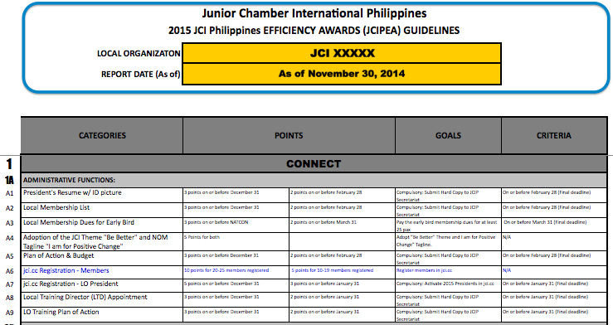
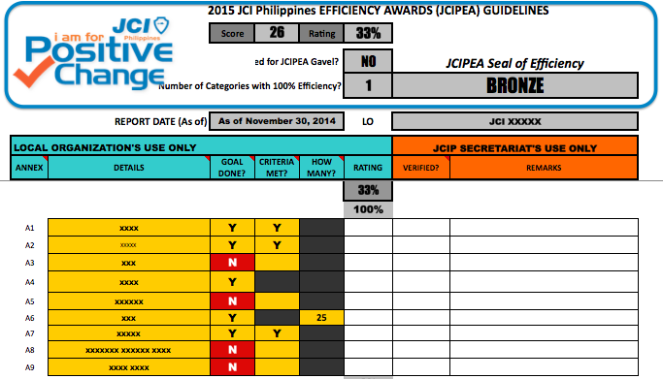
2 Sections:
TEMPLATE
TARGET
Goals and Parameters
ACTUAL
Accomplishments
Notes:
TALKING POINTS:
“Over-all, the JCIPEA Template is composed of 2 main sections: 1) The one on the left side contains all goals and related parameters for each, or the things that we are to accomplish, in short our TARGETS; 2) The one on the right WILL contain whatever we accomplish given the JCIPEA period covered or our ACTUAL accomplishments. This is the only editable part, which we can edit and update to capture what has been done every to date.”

Slide 17
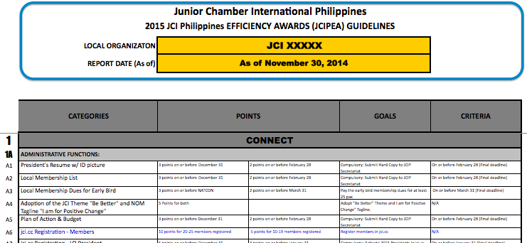
TEMPLATE
TARGET (Goals and Parameters) SECTION
Serve as guide what to do, how and when to do it and the corresponding points that can be earned
JCIPEA Code, cross reference for LO Project Completion Report
BLACK Font – Regular Items used as basis for the divisor in computing for the rating
BLUE Font – Bonus Items, more chances of earning points
Notes:
TALKING POINTS:
“The target section contains 4 key columns: Categories, Points, Goals and Criteria:
CATEGORIES, represents the grouping of similar or related JCIPEA goals for easy monitoring.
POINTS, indicates the available and possible points that can be earned when a goal is completed according to defined criteria
GOALS, determines the deliverables that has to be completed
CRITERIA, determines the parameters that has to be met in completing each deliverable, before the equivalent points can be awarded.
[CLICK]
The JCIPEA CODE will serve as a cross reference for LO Project Completion Report. The corresponding code will have be reflected on the LO Project Completion Report for easy matching by JCIP secretariat during the validation process.
[CLICK]
Items in BLACK are the regular items, which are the only ones accounted in determining primarily the efficiency rating. Total points from the regular items will serve as the basis for the over-all efficiency. Items in BLUE are the bonus items for LOs to earn more points.”

Slide 18
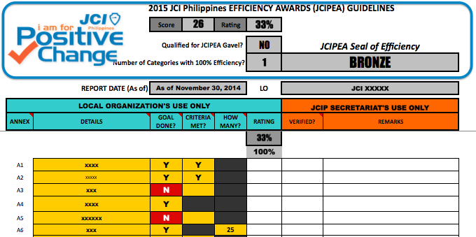
TEMPLATE
ACTUAL (Accomplishments) SECTION
Captures what has been done/achieved by the LO so far, including all scores/ratings achieved.
SNAPSHOT
KNOW YOUR JCIPEA STANDING
anytime, on your own!
Dashboard is automatically generated once you update the template with all the goals completed / criteria met.
RAW SCORE – Total points earned
RATING – Equivalent rating of points earned
GAVEL – Indicates if qualified or not
CATEGORIES 100% – Indicates no. of efficient categories
SEAL OF EFFICIENCY – Indicates the level of efficiency achieved
Notes:
TALKING POINTS:
[CLICK]
“The top portion of the ACTUAL Section is what we call the Performance Snapshot Header. It contains relevant information about the progress of the LO as of a given period.
[CLICK]
RAW SCORE – contains the raw score earned to date, which will also serve as basis for the over-all ranking.
[CLICK]
RATING – contains the equivalent rating from the points earned and will determine whether the LO is qualified for a gavel or not.
[CLICK]
GAVEL – simply indicates whether the LO is already qualified for it or not
[CLICK]
CATEGORIES 100% - indicates the number of categories that are 100% effiicient
[CLICK]
SEAL OF EFFICIENCY – indicates the equivalent Seal of Efficiency that the LO is qualified for to date
[CLICK]
This Snapshot will let you know your JCIPEA Standing, anytime, on your own. This time, you will be in control of your progress!”

Slide 19
TEMPLATE
ACTUAL (Accomplishments) SECTION
Captures what has been done/achieved by the LO so far, including all scores/ratings achieved.
REMARKS – Indicate the details
YES or NO – Indicate whether the goal is done and/or cirteria is met
COUNT – Indicate number of participants, frequency or peso value, as appropriate
Notes:
TALKING POINTS:
“And now for the portion where you are to reflect the updates, these are the editable parts of the template.
DETAILS – indicate your remarks about what has been completed (project title/report, related dates and other key information for reference)
GOAL DONE? and CRITERIA MET? - indicate Y for Yes or N for No, whether the goal is done and/or criteria is met or not.
HOW MANY? – indicate count, as appropriate (either number of projects done, number of persons who completed or participated, number of frequency the goal was accomplished, peso amount raised, etc)
By updating these cells, your Performance Snapshot Header will automatically update itself, and corresponding scores/ratings are generated.”

Slide 20
Update the JCIPEA report based on the activities that will be presented in the next slide.
Teamwork
How to use the JCIPEA Template?
Task:
Notes:
TALKING POINTS:
“Now, let us try the new JCIPEA Template.”

Slide 21
LO Name: JCI Positive Change Report Date: November 30, 2015 Activities: 1. Submitted appointment for LO Training Director and Training Plan 2. Promoted LO online 3. Organized JCI Impact to Project ACT with 20 participating members 4. Co-hosted JCI Achieve with JCI Cebu, with a Trainer from your own LO 5. Hosted a Regional Business Project 6. Awarded Senatorship to 7 members 7. Signed a friendship pact with another LO 8. Conducted Beyond Prison Wall project 9. Activated 2015 LO Presidents jci.cc account 10. Organized a Business Seminar
Teamwork
Notes:
TALKING POINTS:
“Using the template, please reflect the following information.”
NOTES:
Let participants determine the Category for each activity. And then let them update the template.

Slide 22


AWARDS
50 and 100 JCIPEA Points (Raw Score) will qualify the Local Organization to participate in the JCIP Area Conference and National Convention Awards Programs respectively.
100% total JCIPEA Rating (or an average of 20% per Key Result Area) will qualify the LO to receive a Gavel during the National Convention.
Notes:
TALKING POINTS:
“So what is in store for us, for our LOs…
First, as per our National Awards Policy, only LOs with 50 points can submit an entry to Area Awards, and LOs with 100 points can submit for National Awards. So earning JCIPEA points will allow us to vie for various awards.
Second, as per our JCIPEA Guidelines, Reaching 100% rating will qualify us for a Gavel that will be awarded during the Closing Plenary of the Annual National Convention.”

Slide 23

AWARDS
100% Efficiency Rating for each Category will qualify the LO for a Seal of Efficiency that will be awarded during the Annual NatCon Temiong Awards:
PLATINUM 100% Efficiency Rating in all 15 Categories
GOLD 100% Efficiency Rating in 12-14 Categories
SILVER 100% Efficiency Rating in 8-11 Categories
BRONZE 100% Efficiency Rating in 1-7 Categories
Note: The LO will only need to achieve at least 50% of the points from Regular Items (in black) per category to achieve 100% Efficiency. Bonus Items (in blue) are available per category to earn more points.
LOs with Platinum Seal of Efficiency that earned the highest 10 JCIPEA Scores will also be given special recognition during the Area Conference and the National Convention.
Notes:
TALKING POINTS:
“And earning 100% Efficiency rating for each category will qualify us for a Seal of Efficiency.
100% Efficiency in 1 to 7 categories, will qualify us for a Bronze Seal of Efficiency;
8-11 categories, Silver; 12-14, Gold; and a perfect score of 15 categories, Platinum.
LOs with Platinum Seal of Efficiency that earned the highest 10 JCIPEA Scores will also be given special recognition during the Area Conference and the National Convention.

Slide 24
Illustrations
DISCLAIMER:
THIS IS NOT THE RECOMMENDED MIX OF PROGRAMS AND ACTIVITIES, BUT RATHER ONLY AN ILLUSTRATION TO GIVE AN IDEA AND A BENCHMARK AS TO WHAT WOULD IT TAKE TO REACH 100% JCIPEA RATING)
Notes:
TALKING POINTS:
“Now, let us see how easy it is to reach 100% for each category…”

Slide 25
What does it take to achieve 100% Efficiency Rating?
Illustrations
Let’s see how easy it is to reach get a gavel.
Notes:
TALKING POINTS:
“Now, let us see how easy it is to reach 100% overall rating and qualify for a gavel.

Slide 26
What does it take to achieve 100% Efficiency Rating?
Illustrations
Let’s see how easy it is to get a gavel.

Slide 27
What does it take to achieve 100% Efficiency Rating?
Illustrations
Let’s see how easy it is to reach 100% for each category
Notes:
TALKING POINTS:
“Now, let us see how easy it is to reach 100% for each category…”

Slide 28
What does it take to achieve 100% Efficiency Rating?
Illustrations
Let’s see how easy it is to reach 100% for each category
CONNECT – Administrative
100% =
Comply all even not on time, except jci.cc registration of members
OR
Submit the following on time:
-Presidents Resume and ID Picture on due date
-Local Membership List
-Plan of Action and Budget
Avail of Local Membership Dues Early Bird
Adopt NOM Theme
Update jci.cc account – register 10 members
BONUS:
jci.cc registration of members

Slide 29
What does it take to achieve 100% Efficiency Rating?
Illustrations
Let’s see how easy it is to reach 100% for each category
CONNECT – Awards
100% =
5 entries in AreaCon and 5 in NatCon
1 Judge in AreaCon and 1 Judge in NatCon
BONUS:
ASPAC and WorldCon Participation

Slide 30
What does it take to achieve 100% Efficiency Rating?
Illustrations
Let’s see how easy it is to reach 100% for each category
CONNECT – Promotions/PR
100% =
2 Online PR
1 Print Ad
1 JCI Marker/Billboard or equivalent
President’s Attendance in Gala
Promotion of JCI Week
BONUS:
Impact Stories submitted to JCI through jci.cc

Slide 31
What does it take to achieve 100% Efficiency Rating?
Illustrations
Let’s see how easy it is to reach 100% for each category
MOTIVATE – JCI Official Courses
100% =
Organize 1 JCI Impact with 10 new graduates (from own LO)
Organize 1 JCI Achieve with 12 new graduates (from own LO)
Organize JCI Admin with 6 new graduates (from own LO)
BONUS:
New Courses Hosting and Attendance

Slide 32
What does it take to achieve 100% Efficiency Rating?
Illustrations
Let’s see how easy it is to reach 100% for each category
MOTIVATE – Non Official Courses
100% =
1 Parliamentary Procedures Seminar organized with at least 8 members in attendance
1 Project Management Seminar organized with at least 8 members in attendance
3 Opportunity to Impact (New Members Orientation) conducted
1 more other non official course organized with at least 5 members in attendance
BONUS:
ACF discussion and 4 other non official courses organized

Slide 33
What does it take to achieve 100% Efficiency Rating?
Illustrations
Let’s see how easy it is to reach 100% for each category
MOTIVATE – National Training Programs
100% =
1 Trainer Activated who conducted any course to other LO or through joint hosting
LTD’s attendance in a regional or area training forum
1 Member in attendance in a regional or area Avante run
LO Organizing a community training program with at least 5 of its members in attendance
BONUS:
Avante National Training Summit Hosting and Attendance

Slide 34
What does it take to achieve 100% Efficiency Rating?
Illustrations
Let’s see how easy it is to reach 100% for each category
IMPACT – UNMDG
100% =
Implement 3 UNMDG projects in January in celebration of UNMDG Month
BONUS:
2 More UNMDG Goals

Slide 35
What does it take to achieve 100% Efficiency Rating?
Illustrations
Let’s see how easy it is to reach 100% for each category
IMPACT – JCIP National Programs
100% =
Conduct 2 MyWorld Campaign events in January
Give out YLEA to at least 5 students on or before May31
Conduct locally 1 “Beyond Prison Walls” project during April 12-18 JCI Week Celebration
Conduct locally 1 “Bags to School” project in March to June
Conduct locally 1 “Pinay Power” project in March
Implement any project jointly with a Junior JJC in August
Conduct locally 1 project for Peace Month in September
BONUS:
MyWorld Votes gathered, Nothing but Nets Funds raised, JCI Week celebration and OK local level activity implementation up to 5 projects

Slide 36
What does it take to achieve 100% Efficiency Rating?
Illustrations
Let’s see how easy it is to reach 100% for each category
IMPACT – Other Community Programs
100% =
4 Community LO projects implemented
OR
Hosting 1 Regional/Area Community Project + 2 other LO Community projects
BONUS:
4 more LO community projects

Slide 37
What does it take to achieve 100% Efficiency Rating?
Illustrations
Let’s see how easy it is to reach 100% for each category
INVEST – Fund Raising
100% =
2 Fund Raising event organized in a year
BONUS:
4 more Fund Raising projects

Slide 38
What does it take to achieve 100% Efficiency Rating?
Illustrations
Let’s see how easy it is to reach 100% for each category
INVEST – Fund Raising
100% =
Register at least 12 members to JCI Business Trade Directory
BONUS:
JCI MAXX

Slide 39
What does it take to achieve 100% Efficiency Rating?
Illustrations
Let’s see how easy it is to reach 100% for each category
INVEST – Other LO Business Programs
100% =
4 Community LO business seminars or projects implemented
OR
Hosting 1 Regional/Area Business Project + 2 other LO Community projects
BONUS:
4 more LO Business Seminars and/or Projects

Slide 40
What does it take to achieve 100% Efficiency Rating?
Illustrations
Let’s see how easy it is to reach 100% for each category
COLLABORATE – Conferences
100% =
10 members in attendance in Area Conference, including the LO President
10 members in attendance in National Convention, including the LO President
BONUS:
All international (ASPAC, WorldCon and UN Summit) conference attendance

Slide 41
What does it take to achieve 100% Efficiency Rating?
Illustrations
Let’s see how easy it is to reach 100% for each category
COLLABORATE – Meetings and Academies
100% =
LO President Attended
2 RCMs
2 ACMs
either the Midyear or Pres Academy
BONUS:
Hosting of Midyear Presidents Academy or Incoming Presidents Academy

Slide 42
What does it take to achieve 100% Efficiency Rating?
Illustrations
Let’s see how easy it is to reach 100% for each category
COLLABORATE – JCIP Collaboration Programs
100% =
Sponsoring/Chartering 1 JJC Chapter or Attending Alay Lakad with at least 10 members
1 Joint BOD/GMM and 1 Joint Undertaking with another LO
for the Sisterhood/Twinning Program
Hosting 1 Regional or Area Collaboration Project
BONUS:
Nominations for TOYM and TOCP
JCI Senate Investiture
International Twinning and Joint Underdtaking
Public Speaking and World Debating Contests Participation

Slide 43
Module 3: REPORTS
Reporting,
the JCI Way
Notes:
TALKING POINTS:
“Part of being efficient is also submitting the necessary reports. Only then can JCIP account for all your accomplishments and contributions, and recognize you accordingly. The Project Completion Report will substantiate and support your JCIPEA scores and ratings.

Slide 44
MAKE A PROJECT COMPLETION REPORT
Teamwork
Task:
Notes:
NOTES:
Let the participants group into 3-5 and prepare a sample Project Completion Report using the standard JCIP template about a project of their choice in 5 mins. Select one group to present their output to the whole group.

Slide 45
Discussion
Teamwork
What is a project completion report?
-Components
-Requirements
-Deadlines
Was it easy to accomplish? Why or why not?
What makes JCI Local Organization Efficient?
Notes:
NOTES:
Go through the discussion points.
Relate the difficulty of coming up with a Project Completion Report from absence of information/data, which is the tendency if a report is not done immediately after project implementation or if there no records made thereof.
TALKING POINTS:
Part of being efficient is being able to retrieve needed information immediately, and present a comprehensive report fast and accurately. The completeness and accuracy of your Project Completion Report will ensure that corresponding points will be awarded correctly.
Though we use the Project Completion Report for JCIPEA purposes, it is also important to emphasize that other reports are equally important as well, Project Proposal included. By completing the latter, it will make it easy for you to accomplish your Project Completion Report as it contains most of the relevant information about the project.

Slide 46
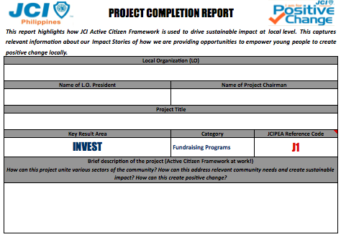
JCIP Reports
To be accomplished for every project completed, including required attachments and photos
To be attached to LO Monthly Accomplishment Report
To be sent in pdf format to JCIP Secretariat naysa88@yahoo.com
For Training Reports, copy in jciptrainingsecretariat@gmail.com
Notes:
To use this particular slide more than once in your presentation you must first copy and paste it because it is not a master and simply selecting new slide will not make it appear again.

Slide 47
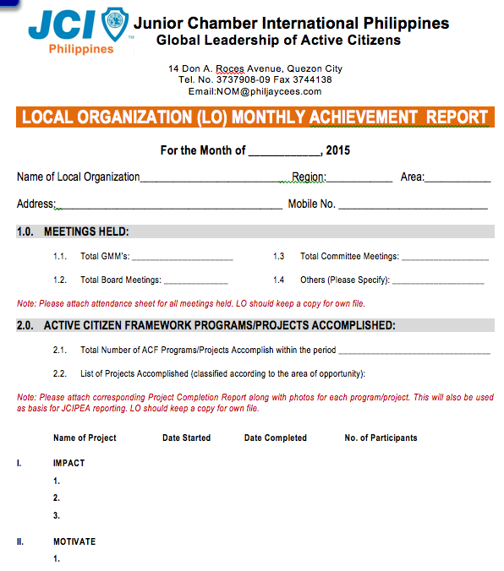
JCIP Reports
To be accomplished for every month
To be sent in pdf format to JCIP Secretariat
Noted and countersigned by RVP and/or Regional Secretary (RSec)
Notes:
To use this particular slide more than once in your presentation you must first copy and paste it because it is not a master and simply selecting new slide will not make it appear again.

Slide 48
Module 4: GO FORWARD PLAN
Drafting our 2015 Go Forward Plan
Notes:
To use this particular slide more than once in your presentation you must first copy and paste it because it is not a master and simply selecting new slide will not make it appear again.

Slide 49
What Seal of Efficiency should you aspire for in 2015? What should you do to ensure higher efficiency and greater performance to achieve our goal? Q&A?
Notes:
NOTES:
Call each LO especially the President and/or Secretary and ask them their target and commitment for 2014. Let the Regional Secretary and/or RVP take note of their commitments.
Address questions from the floor accordingly.
Park and write down those questions needed further clarification and send to NSG for proper response.

Slide 50
Thank you!
GOOD LUCK!
Notes:
TALKING POINTS:
“Let your 2015 journey be awesome, be an EPIC one!”

